Slide 1
CMP203 Graphics Programming
Shadows

Slide 2
Realistic Rendering
OpenGL
We have seen several ways to increase the realism in our scenes and include more detail
Lighting
Texturing
Material Properties
Etc
But we still lack a lot of the common interactions found in reality
As we know, light has a much more complicated behaviour than the simple, diffuse, ambient and specularity model that we use
Using Shaders or not, there are many interesting techniques that we can use to increase realism and also introduce some more special effects!

Slide 3
Realistic Rendering
Shadows
Whenever we add a light into any environment we are able to see its interaction based not only on what the light illuminates, but what it does not
We can easily show some aspects of this in OpenGL Automatically
Reduced illumination on sides of objects not facing light
But this does not even begin to cover all the aspects of shadowing and other related effects
There are many techniques which we can use to re-create these behaviours and increase the realism of our own scene

Slide 4
Shadows
In games, essentially we have two options
Pre-calculated
Real-time Shadows
These are two separate problems

Slide 5
Shadows
Pre-Calculated shadows
Typically shown in the level environment as part of a lightmap created for the level itself at compile time
Rendered with a multi-textured effect
These tend to be from static light sources onto static objects

Slide 6
Shadows
Real-time shadows
Shadows generated by moving objects / light sources in the game
Usually important things such as the player or NPC’s

Slide 7
Shadows
Considerations
Though it is possible to quite accurately simulate shadows it doesn’t mean we SHOULD
Performance is paramount
If the nature of the game means that the player wouldn’t ever see that the rendered shadow isn't accurate, do not make it accurate
Keep requirements of the game in mind

Slide 8
Shadows
Many types of shadows
Shadow imposter
Planar projected shadow
Shadow volumes
Shadow maps
etc

Slide 9
Shadow Impostors
Concept
This is the simplest cheapest option for including simple shadow detail in an application
An Alpha Mapped quad placed beneath the object we wish to have a shadow
Quad is textured with a generic ‘round’ shadow texture

Slide 10
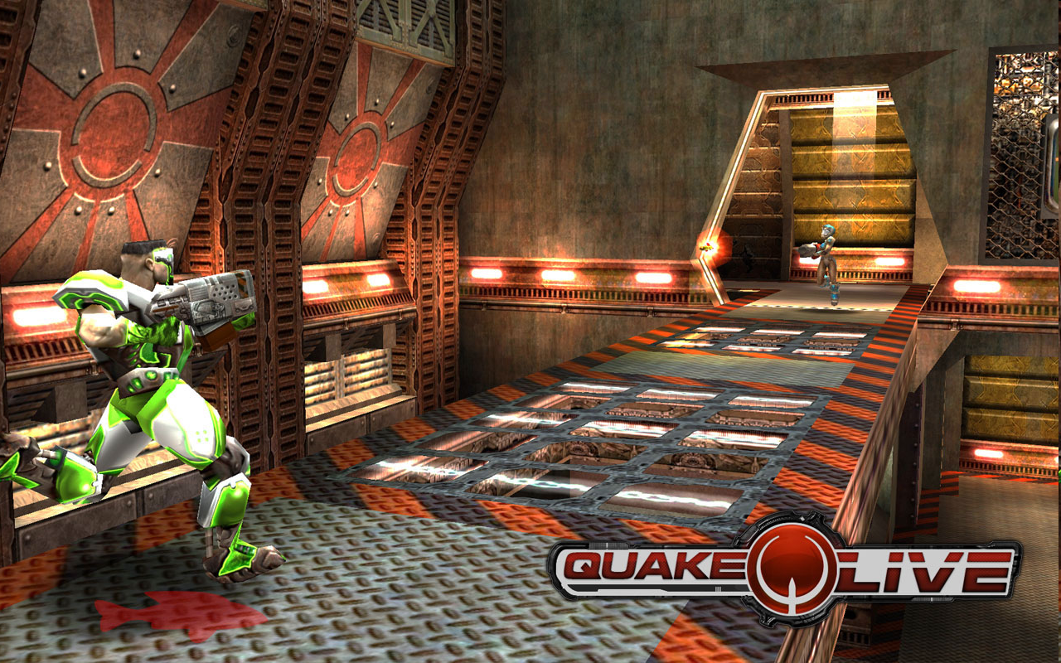
Shadow Impostors

Slide 11
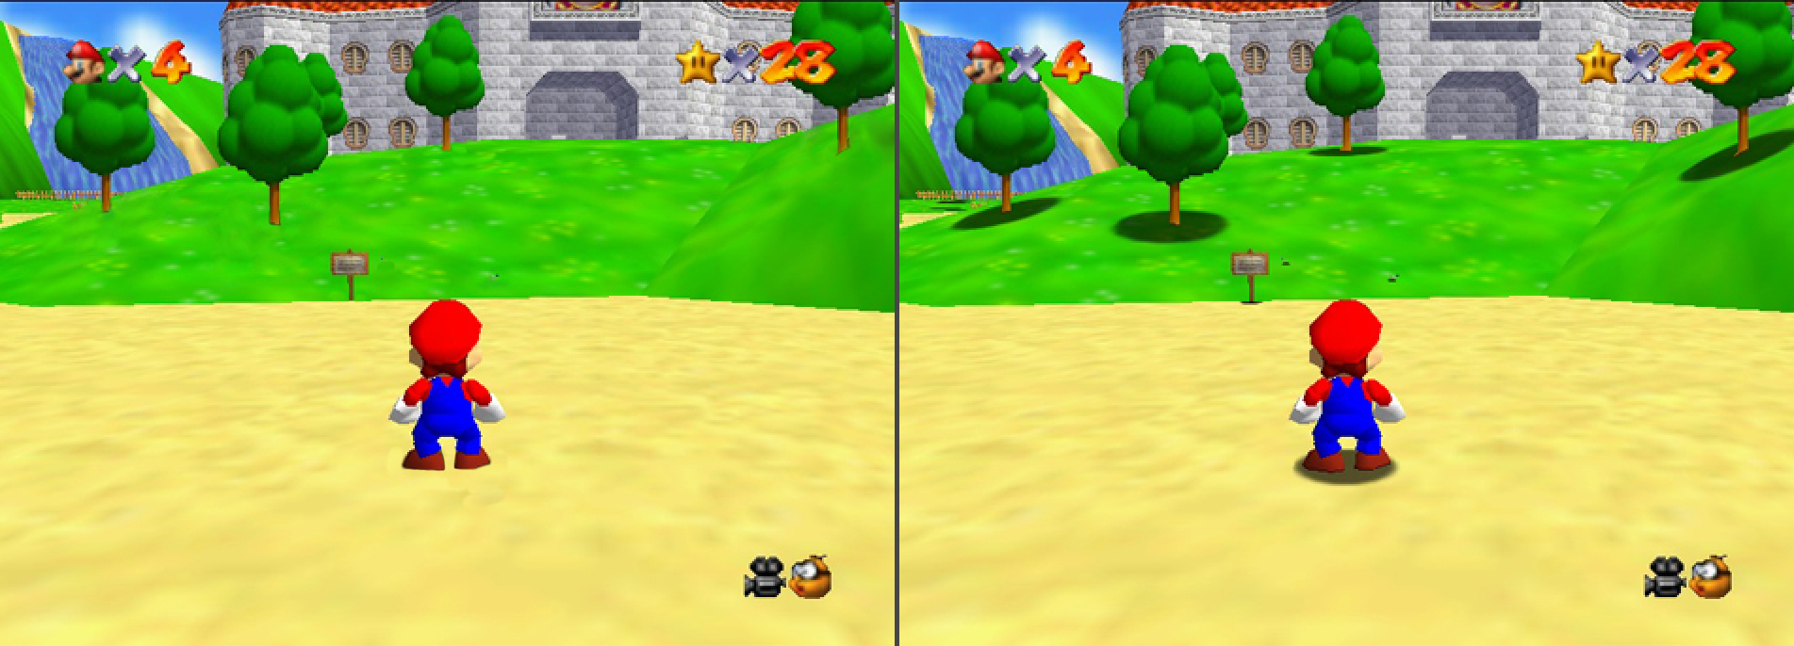
Mario

Slide 12
Shadow Impostors
Advantages / Disadvantages
Cheap to process
Easy to implement
Still often used in games
Given a appropriate game type the user will never know
Possible to animate shadow
Does not take into account light direction
Not suited to any game where lighting is an integral part of the overall effect
Basically, even this simple effect does the job of “Cementing” an object into the scene

Slide 13
Planer shadows
Planar shadows are created by building a special matrix transform which flattens an object's geometry into a plane when rendered and is definitely one of the simplest ways of creating real-time shadows
Unfortunately, planar shadows are only useful when projected onto planar surface like a wall or floor so their use in modern applications or games is quickly falling out of favour

Slide 14
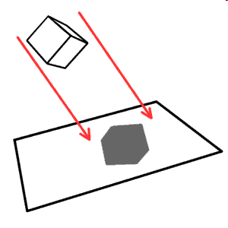
Planar Projection Shadows
Concept
Object is rendered twice, once to display the object. Again to represent the shadow
Object is given a transform that has the effect of projecting it onto a flat surface based on light source information
Object is then Rendered as a black, texture-less object with transparency.
Good Approximation

Slide 15
Planar Projection Shadows
Deriving the projection / shadow matrix
Needed Information
Light Position
Position of vertex to be transformed
Information about the Plane we are going to project onto (Point on plane and Surface normal)
Deriving the matrix from these variables involves a fair bit of algebra
But can be encapsulated in a reasonably straightforward function

Slide 16
Planar Projection Shadows
Advantages / Disadvantages
Produces accurate shadows
Geometry associated with object rendering has doubled!
Shadow Overlap (sometimes)
Limited to a single projection surface
Z- Sorting,
Object needs to be drawn after the plane, with Z- buffer off
This method has largely been superseded by superior techniques

Slide 17
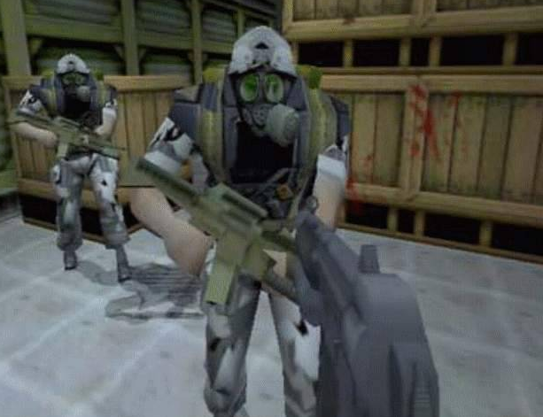
Planar Projection Shadows

Slide 18
Adding the stencil buffer
Using a Stencil test with projected shadows
Setup our shadow as before, create the shadow matrix and apply it before rendering the shadow
When rendering, we use the stencil buffer to ensure we do not ‘overwrite’ any of the pixels from the shadow that have already been created
Each pixel that is drawn sets a value in the stencil buffer

Slide 19
Adding the stencil buffer
Advantages / Disadvantages
Same as Planar projection
No ‘Overlap’ in the shadow so visually much better
Difficult if we are projecting a shadow onto a complex surface

Slide 20
Shadow volume
Also referred to as Stencil Shadowing
Render the scene multiple times
Create a volume that represents where the light falls in the scene
Build a stencil for geometry that falls within (or out with) the volume
Render the scene twice
Once in shadow
Once being lit
Based on stencil values
Requires a large amount of multi pass rendering
Looks great!

Slide 21
Shadow Volume
Several approaches to shadow volume rendering
Depth Pass
Depth Fail
Exclusive-or
All use the basic approach outlined on the last slide
The above techniques differ on the approach to calculating what lies inside the volume

Slide 22
Depth pass
Disable writing to the depth and colour / frame buffers
Use back face culling
Set stencil operation to increment on depth pass
Render the shadow volume
Use front face culling
Set stencil operation to decrement on depth pass
Render shadow volume
After this all lit surfaces have a stencil value of zero

Slide 23
Others
Depth fail
Solves some of the issues from depth pass
Counts the shadow surfaces behind an object instead of in front (just as easy)
Same result
Often referred to as Carmack’s Reverse

Slide 24
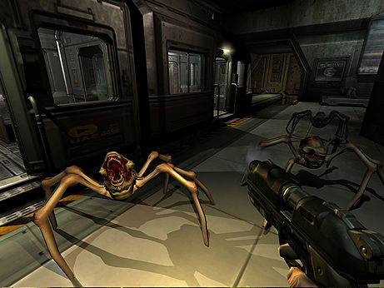
Shadow volume

Slide 25
Shadow mapping
AKA projective shadowing
First create shadow map
Render scene from lights position
Store depth data
For each light
Rendering
Multi pass for each light
Test against depth data for the light
Add light if test passes

Slide 26
Shadow mapping
Disadvantages
Requires large shadow and depth map
Shadows are riddled with visible aliasing issues and glitches
Requires large amount of multi pass rendering
Creates hard shadows
Further work is required to soften the shadows
Yet more processing

Slide 27
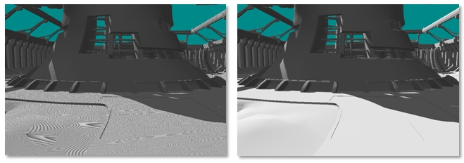
Shadow mapping

Slide 28
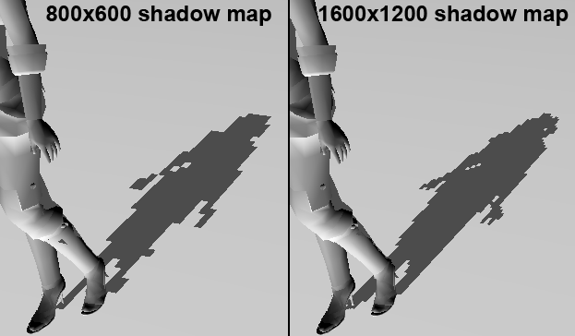
Shadow mapping

Slide 29
Examples
I will now attempt to go through a couple of examples
Shadow imposter
Planar shadow
Shadow volume
Prepare yourselves

Slide 30
Example scene
Here is the simple scene we will be adding shadows to
A light
Floor
Floating object (teapot)

Slide 31
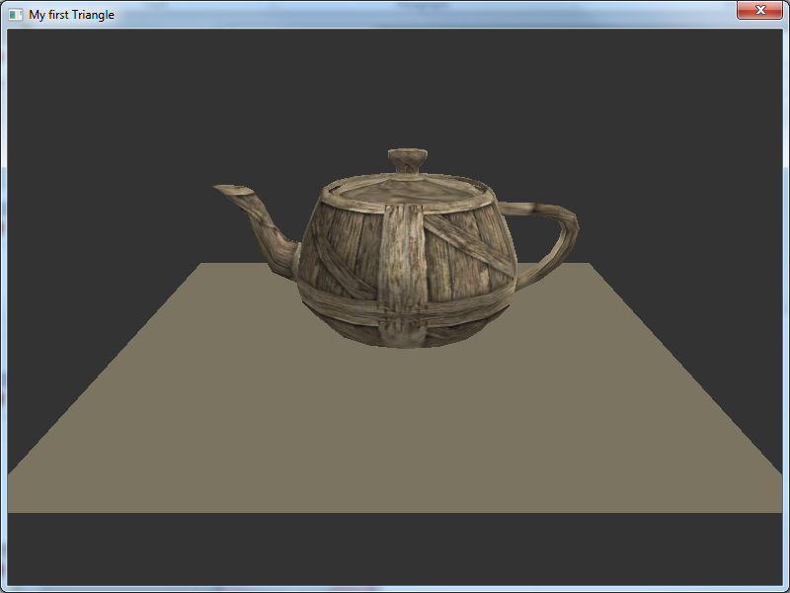
The scene

Slide 32
Shadow imposter
Enable a light
Render the floor
A simple quad with normals
Render the imposter
Disable lighting
Enable blending
Render quad with imposter texture
Disable blending
Enable lighting
Render object (teapot)

Slide 33

Shadow imposter
Imposter texture looks like this
The imposter may require depth test to be disabled
Or to be translated a very small amount
To stop z-fighting with floor
Use the stencil to determine if the imposter should be rendered

Slide 34
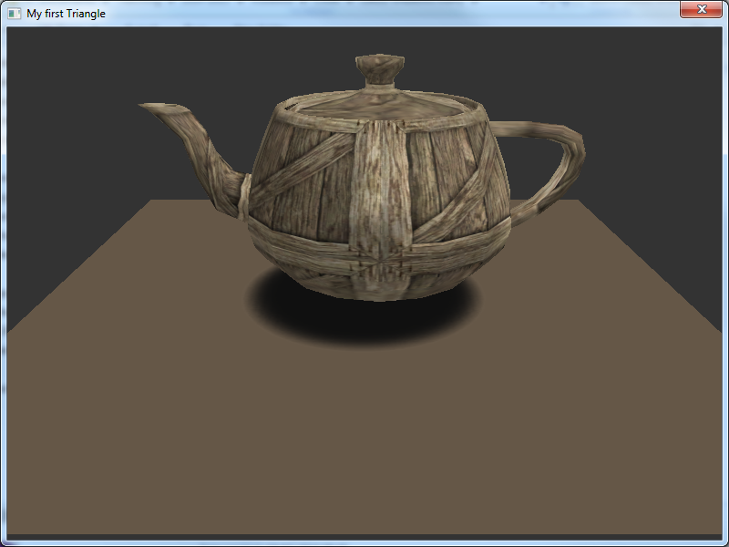

Slide 35
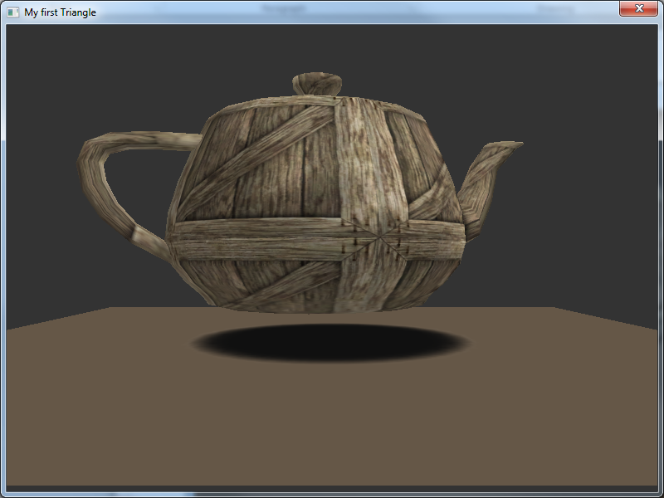

Slide 36
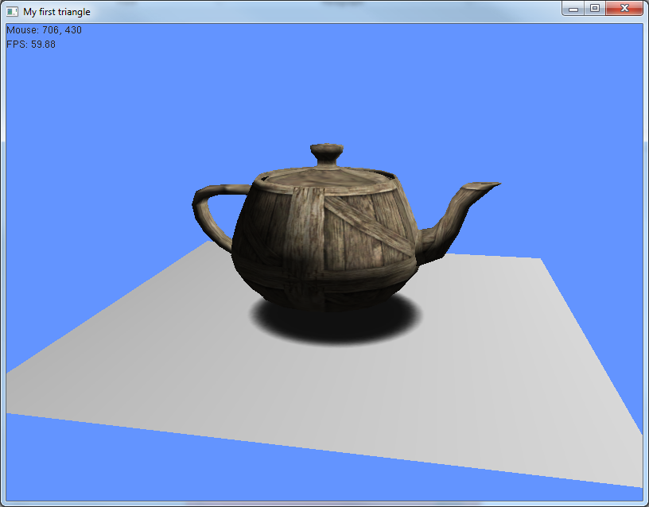

Slide 37
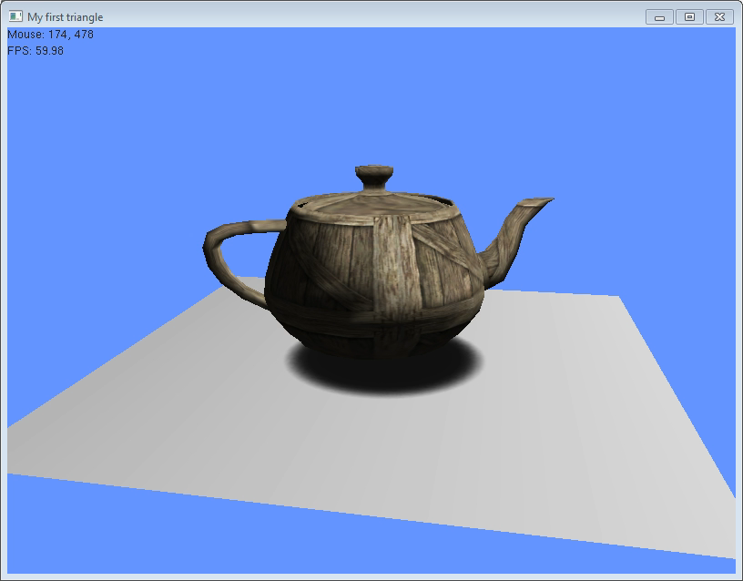

Slide 38
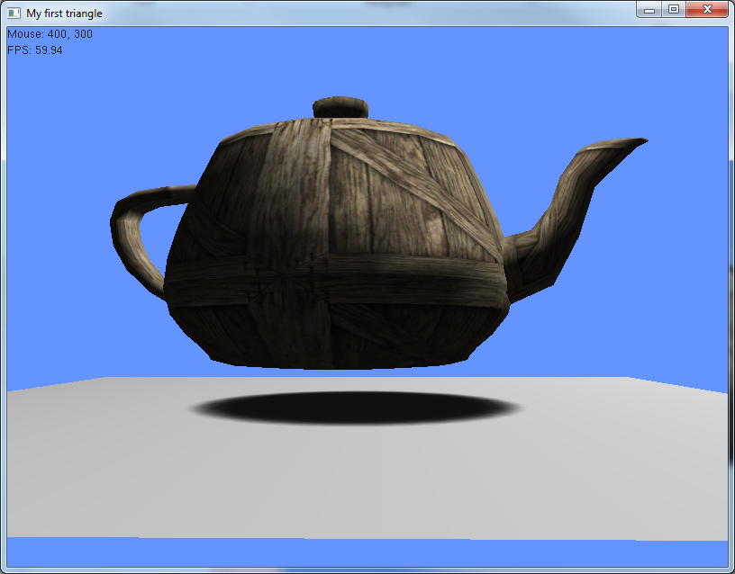

Slide 39
Planar shadow
Same example scenario
Light, teapot, floor
This time we will create a shadow matrix that will deform our shape (teapot) to create the shadow
For this we need a few extra things
A matrix
float shadowMatrix[16]
A plane that matches the floor

Slide 40
Example
Setup the values presenting our floor
Really only need two vectors to describe the plane
But with this it would be possible to render the floor with the data
GLfloat floorVerts[] = { -1.f, -1.f, -1.f,//top left
-1.f, -1.f, 1.f,// bottom left
1.f, -1.f, 1.f,//bottom right
1.f, -1.f, -1.f };// top right

Slide 41
Generate shadow matrix
I will provide this function
It creates a projection matrix based on the lights position and the plane that represents the floor
When applied the transformation will flatten an object onto the plane based on the lights position

Slide 42
Render process
Setup light
Define plane
Generate shadow matrix, using
Empty shadow matrix variable (within the class)
Light position
Plane object
Render floor
Render shadow
Disable depth test, lighting and texture
Apply shadow matrix transform
Render object (with translate, rotate and scale if required)
Re-enable lighting, depth test and texture
Render object with corresponding translate, rotate and scale

Slide 43
Example
glDisable(GL_DEPTH_TEST);
glDisable(GL_LIGHTING);
glDisable(GL_TEXTURE_2D);
glColor3f(0.1f, 0.1f, 0.1f); // Shadow's colour
glPushMatrix();
glMultMatrixf((GLfloat *)shadowMatrix);
//translate to floor and draw shadow, remember to match any transforms on the object
glTranslatef(0.f, 1.f, 0.f);
glRotatef(rotation, 0.f, 1.f, 0.f);
glScalef(0.2f, 0.2f, 0.2f);
model.render();
glPopMatrix();
glColor3f(1.0f, 1.0f, 1.0f); // S
glEnable(GL_DEPTH_TEST);
glEnable(GL_LIGHTING);
glEnable(GL_TEXTURE_2D);

Slide 44
Example
//render object
glPushMatrix();
glTranslatef(0.f, 1.f, 0.f);
glRotatef(rotation, 0.f, 1.f, 0.f);
glScalef(0.2f, 0.2f, 0.2f);
model.render();
glPopMatrix();

Slide 45
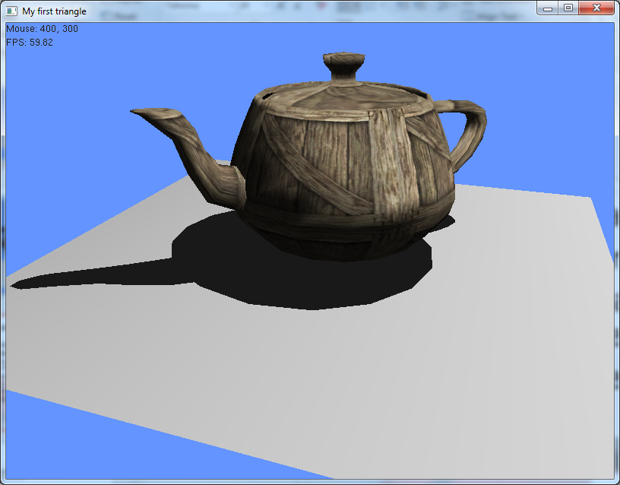

Slide 46
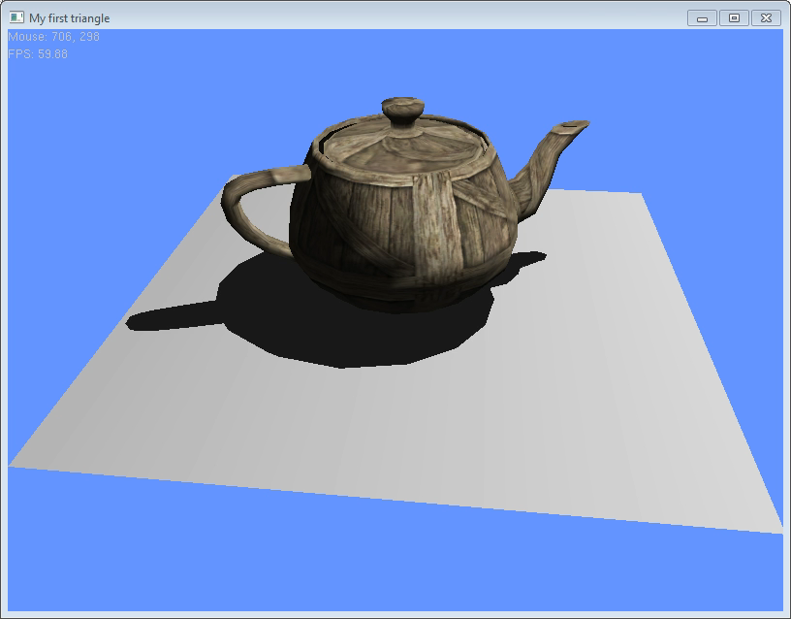

Slide 47
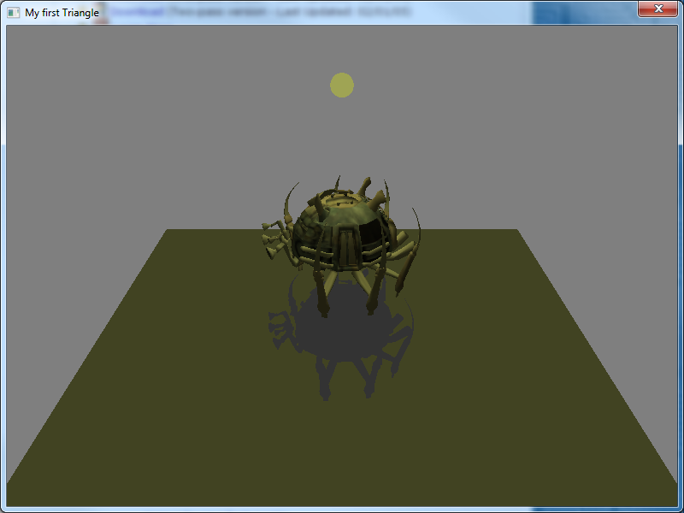
Normal, light directly above

Slide 48
Example
Move the light up

Slide 49
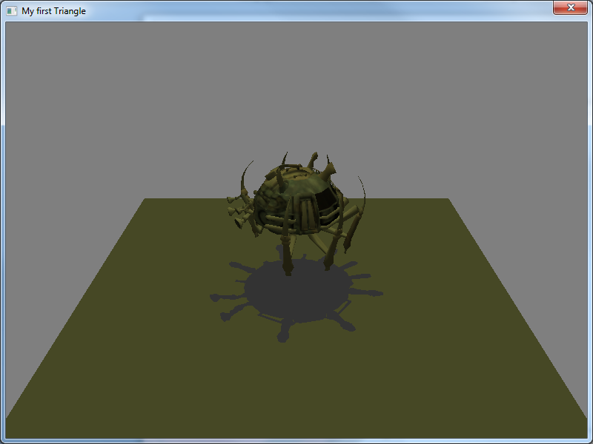
Light moved up

Slide 50
Example
Move the light closer to the object

Slide 51
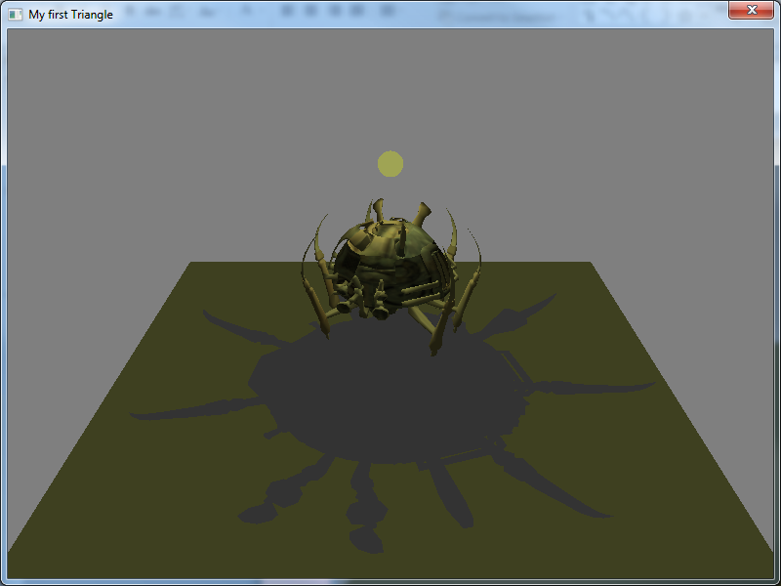
Closer

Slide 52
Challenges
Shadows are not limited to the floor object
Be careful when positioning the light

Slide 53
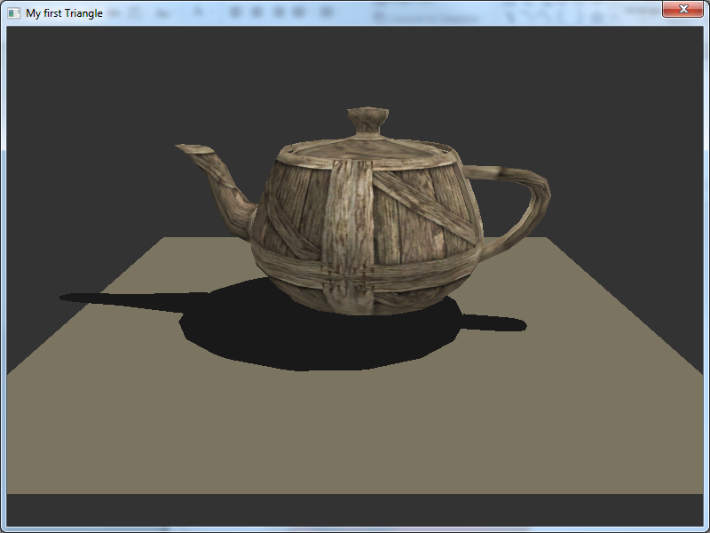

Slide 54
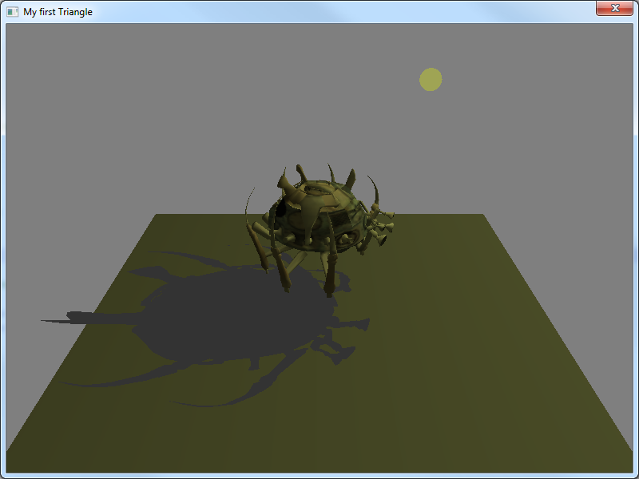

Slide 55
Example
Not to close though

Slide 56
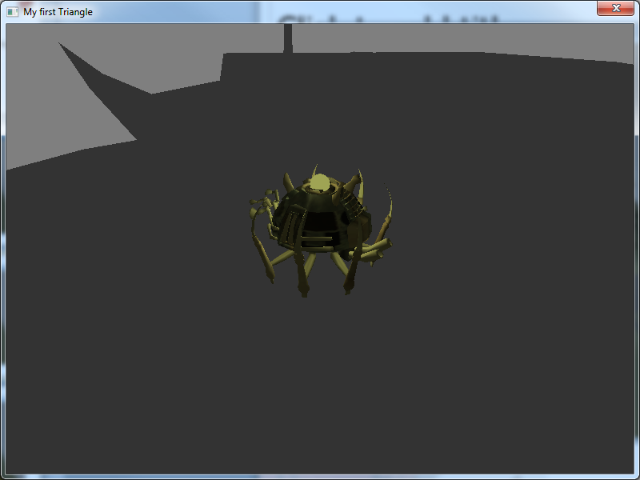
Not to close

Slide 57
Whoops
Requires the stencil buffer to be used to cull the shadow from protruding beyond the edge of the shadow receiver
BUT
I’m not going to show you how ☺

Slide 58
Shadow volume
Using the lights position and a object (shadow caster)
Create a shadow volume
Stencil buffer is used to determine if an object falls in shadow
Requires rendering parts of the scene multiple times

Slide 59
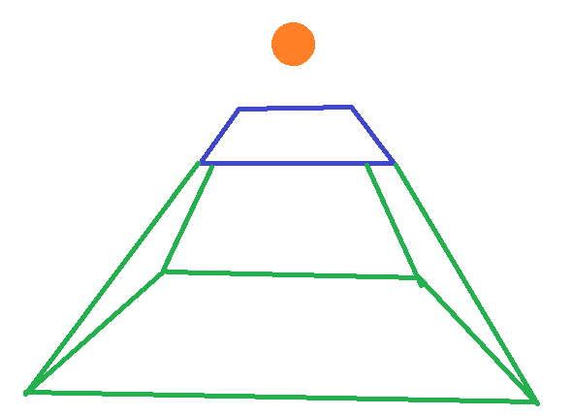
Shadow volume
Created using the light position and the vertices of the shadow caster
Extending them to create the shadow volume
I will provide example functions

Slide 60
Shadow volume
extendVertex()
Given a vertex position
Light position
Extend value
Creates a new vertex

Slide 61
Shadow volume
Build shadow volume ()
Given shadow caster data
Light position
Extend value
Builds a shadow volume
Calls extend vertex()
Create the shadow volume shape
Stores it in a display list

Slide 62
Example
The scene similar to before
Floor
Object (teapot)
Added a shadow caster (quad above the teapot)
The whole scene will be re-render several times
To make this easier all the calls to render the above have been combined into a single function
renderScene()

Slide 63
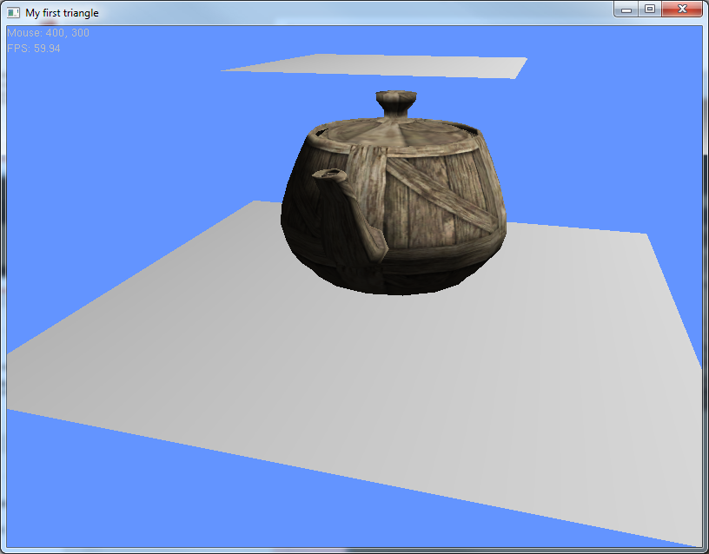

Slide 64
Example
Putting it all together
Render
Setup and enable light
Build shadow volume (shadow caster, light position )
Disable rendering to frame buffer
So we can render only to depth buffer
Render scene ()

Slide 65
Example
Cull back face
Enable stencil test
Turn of writing to depth buffer (still do depth test, but do not update buffer)
Stencil function (always , 0, 0)
Stencil op (keep, keep, increment)
Render shadow volume

Slide 66
Example
Stencil op ( keep, keep, decrement)
Cull front face
Render shadow volume

Slide 67
Example
Re-enable depth mask
Re-enable render to frame buffer
Stencil op (keep, keep, keep)
Disable cull face

Slide 68
Example
(render shadow part of scene)
Stencil function (equal, 1, 1)
Turn off light
Render scene ()

Slide 69
Example
(render lit part)
Stencil function (equal, 0, 1)
Turn on light
Render scene()
Tidy up
Disable stencil test
In my example I also render the shadow volume outline so you can see it

Slide 70
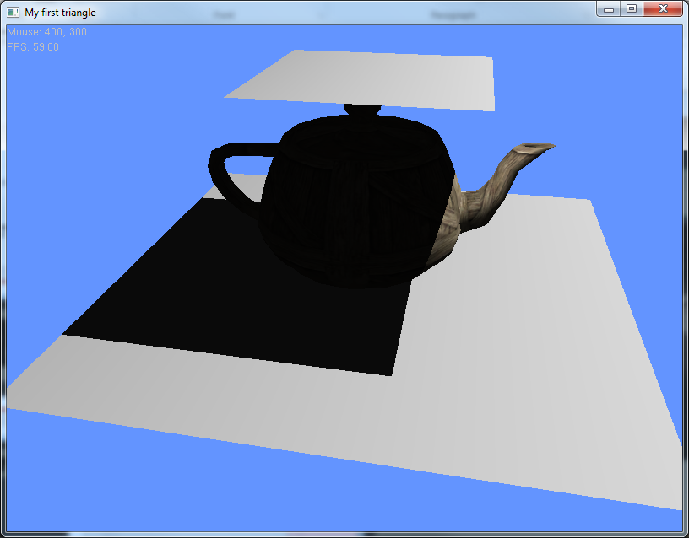

Slide 71
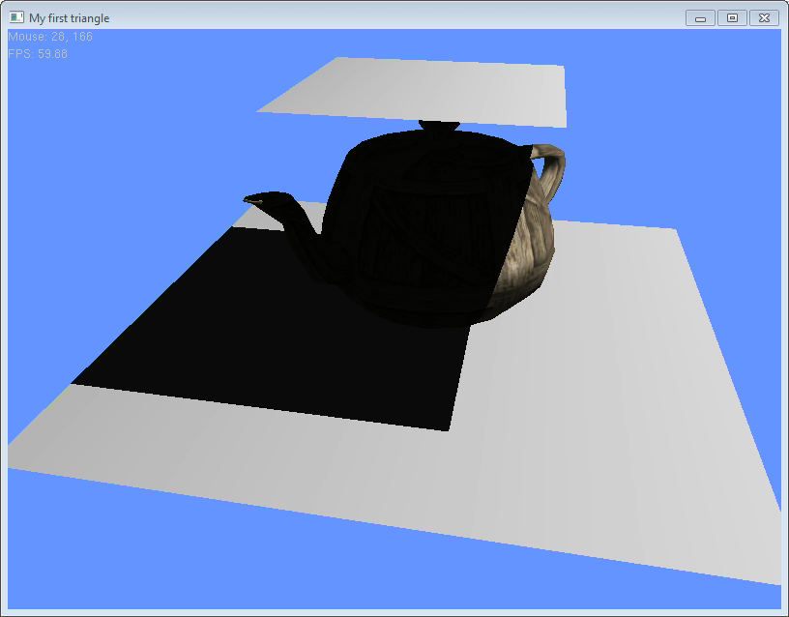

Slide 72
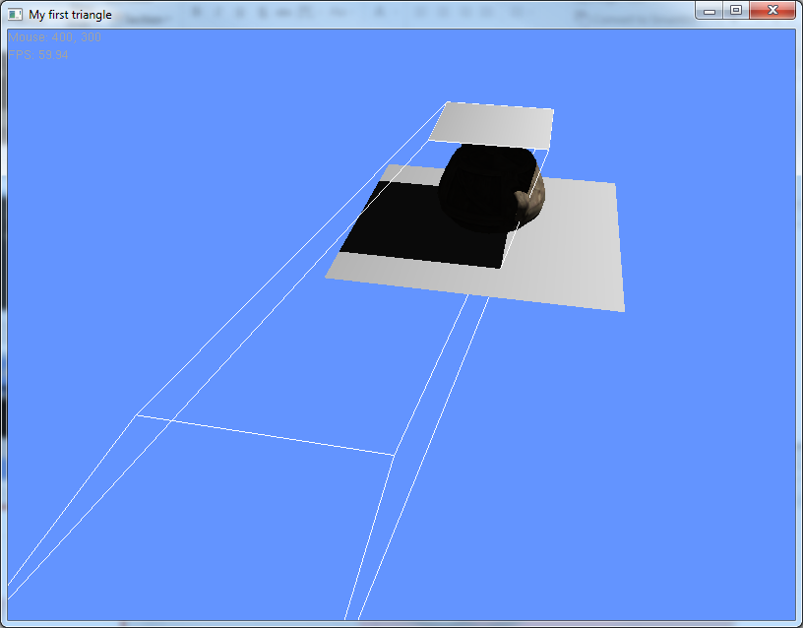

Slide 73
Shadow volume
Can control size of shadow volume (extend / extrusion value)
Reduce risk of shadows appearing on other geometry
This is a fairly simple example of a shadow volume. It demonstrates the basics required to create a shadow volume but doesn’t handle special case problems
Camera inside the shadow volume
Producing shadow volumes of more complex objects which requires edge detection
It also doesn’t like it if the shadow caster moves
Should handle the light moving

Slide 74
Recommended Reading
Nehe shadow volume tutorial
http://nehe.gamedev.net/tutorial/shadows/16010/
Books
Real-time Rendering –Moller / Haines
Shadow mapping – Big Blue book of OpenGL Chapter 14

Slide 75
The labs
Investigate a shadow technique of your choice
Shadow Imposter
Planar shadow
Shadow volume
Use lab time for catch up and coursework

